Slide 1
Important Deep Learning Terms
Before proceeding, there are a few terms that you should be familiar with.
Epoch – The number of times the algorithm runs on the whole training dataset.
Sample – A single row of a dataset.
Batch – It denotes the number of samples to be taken to for updating the model parameters.
Learning rate – It is a parameter that provides the model a scale of how much model weights should be updated.
Cost Function/Loss Function – A cost function is used to calculate the cost, which is the difference between the predicted value and the actual value.
Weights/ Bias – The learnable parameters in a model that controls the signal between two neurons.

Slide 2
Activation functions in Neural Networks

Slide 3
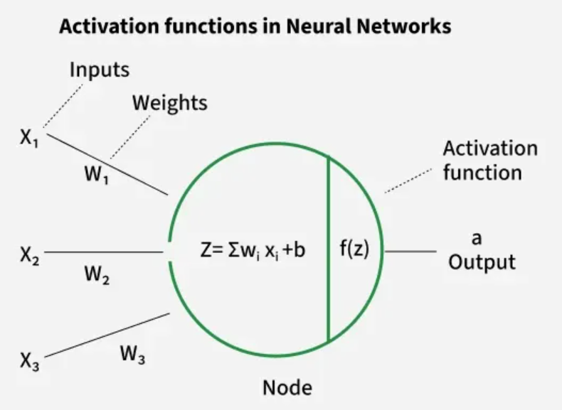
Activation function
An activation function in a neural network is a mathematical function applied to the output of a neuron. It introduces non-linearity, enabling the model to learn and represent complex data patterns. Without it, even a deep neural network would behave like a simple linear regression model.
Activation functions decide whether a neuron should be activated based on the weighted sum of inputs and a bias term. They also make backpropagation possible by providing gradients for weight updates.

Slide 4
Why Non-Linearity is Important
Real-world data is rarely linearly separable.
Non-linear functions allow neural networks to form curved decision boundaries, making them capable of handling complex patterns (e.g., classifying apples vs. bananas under varying colors and shapes).
They ensure networks can model advanced problems like image recognition, NLP and speech processing.

Slide 5
Types of Activation Functions in Deep Learning
Sigmoid Function
Tanh Activation Function
ReLU (Rectified Linear Unit) Function
Leaky ReLU
Softmax Function
SoftPlus Function

Slide 6
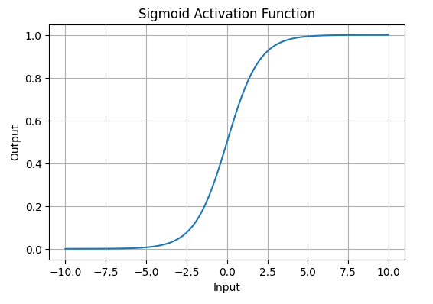
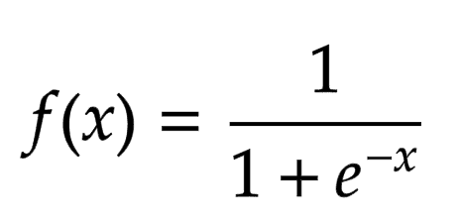
Sigmoid Function
It is characterized by 'S' shape. It is mathematically defined as
It allows neural networks to handle and model complex patterns that linear equations cannot.
The output ranges between 0 and 1, hence useful for binary classification.

Slide 7
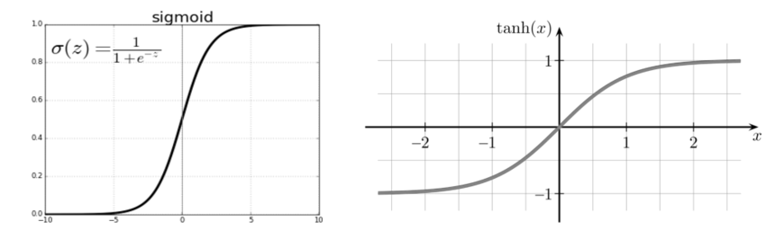
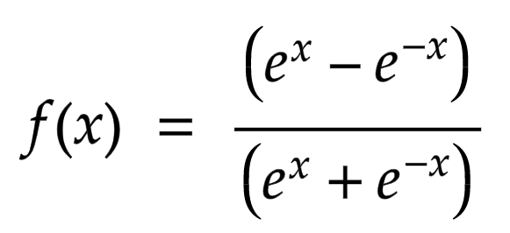
Tanh Activation Function
It is a shifted version of the sigmoid, allowing it to stretch across the y-axis.
Value Range: Outputs values from -1 to +1.
Non-linear: Enables modeling of complex data patterns.
Use in Hidden Layers: Commonly used in hidden layers due to its zero-centered output, facilitating easier learning for subsequent layers.

Slide 8

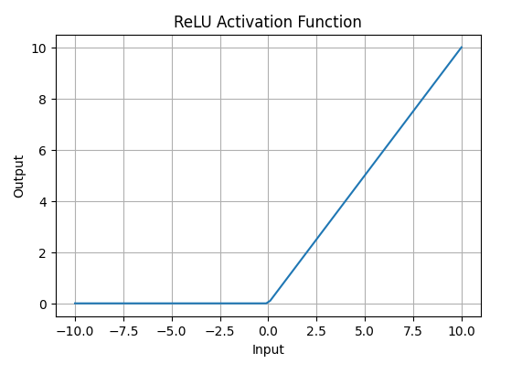
ReLU (Rectified Linear Unit)
Function
If the input x is positive, ReLU returns x, if the input is negative, it returns 0.
Value Range: [0,∞), meaning the function only outputs non-negative values.
Nature: It is a non-linear activation function, allowing neural networks to learn complex patterns and making backpropagation more efficient.
Advantage over other Activation: ReLU is less computationally expensive than tanh and sigmoid because it involves simpler mathematical operations

Slide 9
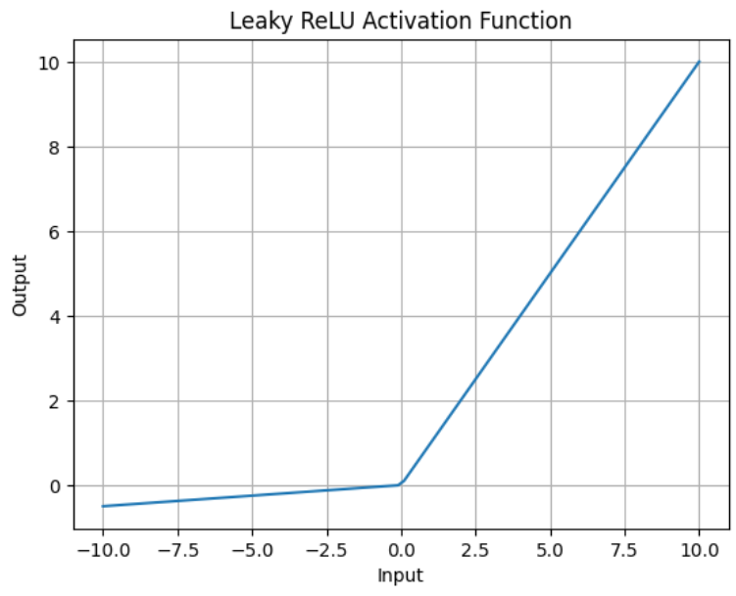
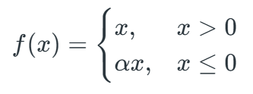
Leaky ReLU
It is similar to ReLU but allows a small negative slope (α, e.g., 0.01) instead of zero.
Solves the “dying ReLU” problem, where neurons get stuck with zero outputs.
Range: (−∞,∞).
Preferred in some cases for better gradient flow.

Slide 10
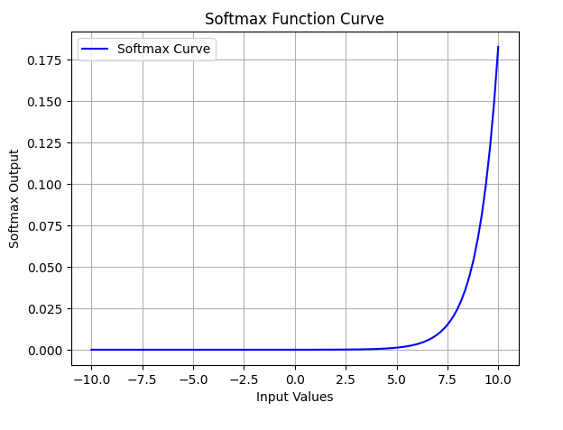
Softmax Function
It is designed to handle multi-class classification problems. It transforms raw output scores from a neural network into probabilities.
It works by squashing the output values of each class into the range of 0 to 1 while ensuring that the sum of all probabilities equals 1.
The Softmax function ensures that each class is assigned a probability, helping to identify which class the input belongs to.

Slide 11
Impact of Activation Functions on Model Performance
The choice of activation function has a direct impact on the performance of a neural network in several ways:
Convergence Speed: Functions like ReLU allow faster training by avoiding the vanishing gradient problem while Sigmoid and Tanh can slow down convergence in deep networks.
Gradient Flow: Activation functions like ReLU ensure better gradient flow, helping deeper layers learn effectively. In contrast Sigmoid can lead to small gradients, hindering learning in deep layers.
Model Complexity: Activation functions like Softmax allow the model to handle complex multi-class problems, whereas simpler functions like ReLU or Leaky ReLU are used for basic layers.

Slide 12
Optimization Rule in Deep Neural Networks

Slide 13
What is an Optimizer?
An optimizer is a function or an algorithm that modifies the attributes of the neural network, such as weights and learning rate. Thus, it helps in reducing the overall loss and improve the accuracy and can help reduce training time exponentially. These are solvers of minimization problems in which the function to minimize has a gradient.
Why Optimizers Matter
Control how quickly and effectively a model learns
Balance between speed of convergence and accuracy
Help escape local minima in the loss landscape
Key Points:
Choice of optimizer affects training speed and model accuracy
Adam is most popular for general use
Experiment with learning rate scheduling and optimizer combinations for best results

Slide 14

The optimizer’s role is to find the best combination of weights and biases that leads to the most accurate predictions.
In deep learning, optimizers and loss functions are two fundamental components that help improve a model’s performance.
A loss function evaluates a model's effectiveness by computing the difference between expected and actual outputs.
An optimizer improves the model by adjusting its parameters (weights and biases) to minimize the loss function value.

Slide 15
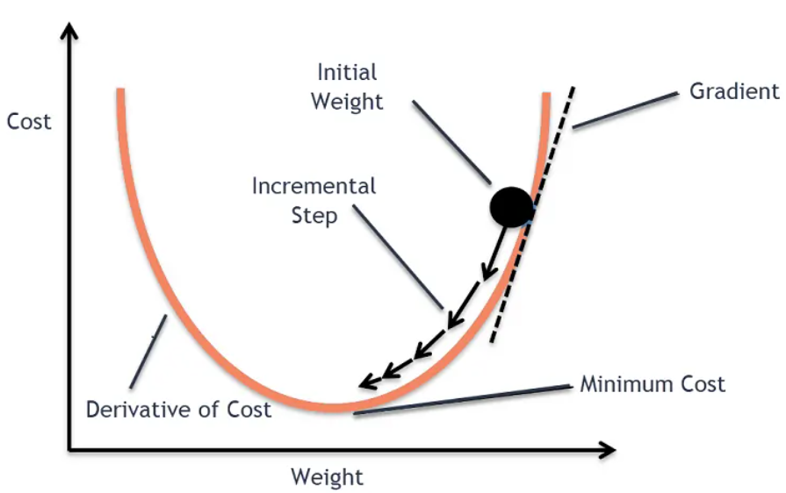
Gradient Descent
Gradient descent is an optimization algorithm used in machine learning to minimize the cost function by iteratively adjusting parameters in the direction of the negative gradient, aiming to find the optimal set of parameters.
Key Steps in Gradient Descent
Initialize parameters: Randomly initialize the model parameters.
Compute the gradient: Calculate the gradient (derivative) of the loss function with respect to the parameters.
Update parameters: Adjust the parameters by moving in the opposite direction of the gradient, scaled by the learning rate.
The learning rate, a hyperparameter, determines the step size taken in each iteration, influencing the speed and stability of convergence.
Notes:
Example of Gradient Descent Algorithm
Let’s say you are playing a game in which the players are at the top of a mountain and asked to reach the lowest point of the mountain. Additionally, they are blindfolded. So, what approach do you think would make you reach the lake?
Take a moment to think about this before you read on.
The best way is to observe the ground and find where the land descends. From that position, step in the descending direction and iterate this process until we reach the lowest point.
Finding the lowest point in a hilly landscape.
Gradient descent is an iterative optimization algorithm for finding the local minimum of a function.
To find the local minimum of a function using gradient descent, we must take steps proportional to the negative of the gradient (move away from the gradient) of the function at the current point. If we take steps proportional to the positive of the gradient (moving towards the gradient), we will approach a local maximum of the function, and the procedure is called Gradient Ascent.
The goal of the gradient descent algorithm is to minimize the given function (say, cost function). To achieve this goal, it performs two steps iteratively:
Compute the gradient (slope), the first-order derivative of the function at that point
Make a step (move) in the direction opposite to the gradient. The opposite direction of the slope increases from the current point by alpha times the gradient at that point

Slide 16

Stochastic Gradient Descent (SGD)
It is a variant of Gradient Descent.
SGD updates model weights after each batch (or sample) rather than the full dataset — this makes it faster but noisier.
If the model has 10K dataset SGD will update the model parameters 10k times.
Where:
η: learning rate
∇θL(θ): gradient of loss w.r.t. weights
Notes:
Example of Gradient Descent Algorithm
Let’s say you are playing a game in which the players are at the top of a mountain and asked to reach the lowest point of the mountain. Additionally, they are blindfolded. So, what approach do you think would make you reach the lake?
Take a moment to think about this before you read on.
The best way is to observe the ground and find where the land descends. From that position, step in the descending direction and iterate this process until we reach the lowest point.
Finding the lowest point in a hilly landscape.
Gradient descent is an iterative optimization algorithm for finding the local minimum of a function.
To find the local minimum of a function using gradient descent, we must take steps proportional to the negative of the gradient (move away from the gradient) of the function at the current point. If we take steps proportional to the positive of the gradient (moving towards the gradient), we will approach a local maximum of the function, and the procedure is called Gradient Ascent.
The goal of the gradient descent algorithm is to minimize the given function (say, cost function). To achieve this goal, it performs two steps iteratively:
Compute the gradient (slope), the first-order derivative of the function at that point
Make a step (move) in the direction opposite to the gradient. The opposite direction of the slope increases from the current point by alpha times the gradient at that point

Slide 17
AdaGrad(Adaptive Gradient Descent)
The intuition behind AdaGrad is can we use different Learning Rates for each and every neuron for each and every hidden layer based on different iterations.
It adapts the learning rate for each parameter based on the historical gradient information.
The learning rate decreases over time, making AdaGrad effective for sparse features.
Advantages: Adapts the learning rate, improving training efficiency.
Disadvantages: Learning rate decays too quickly, causing slow convergence.

Slide 18
Adam (Adaptive Moment Estimation)
It uses both the first moment (mean) and second moment (variance) of gradients to adapt the learning rate for each parameter.
Pros
Fast convergence
Adapts learning rate dynamically
Default optimizer for most DL frameworks

Slide 19
THANK YOU!

